Slide 1


6120 Capstone B: Short Term Forecasting of Solar Radiation
Advisor:
Bradley Blanchard
Ashwin Thota
BY:
Lijju Mathew
Paritosh Rai
Sid Swarupananda

Slide 2

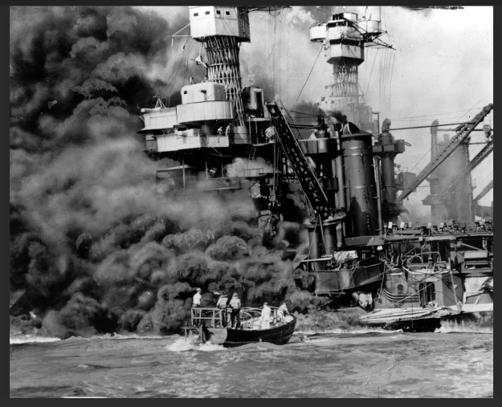
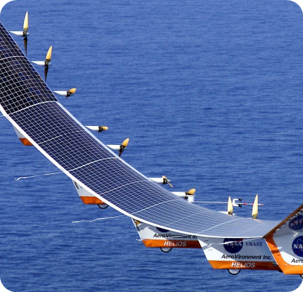
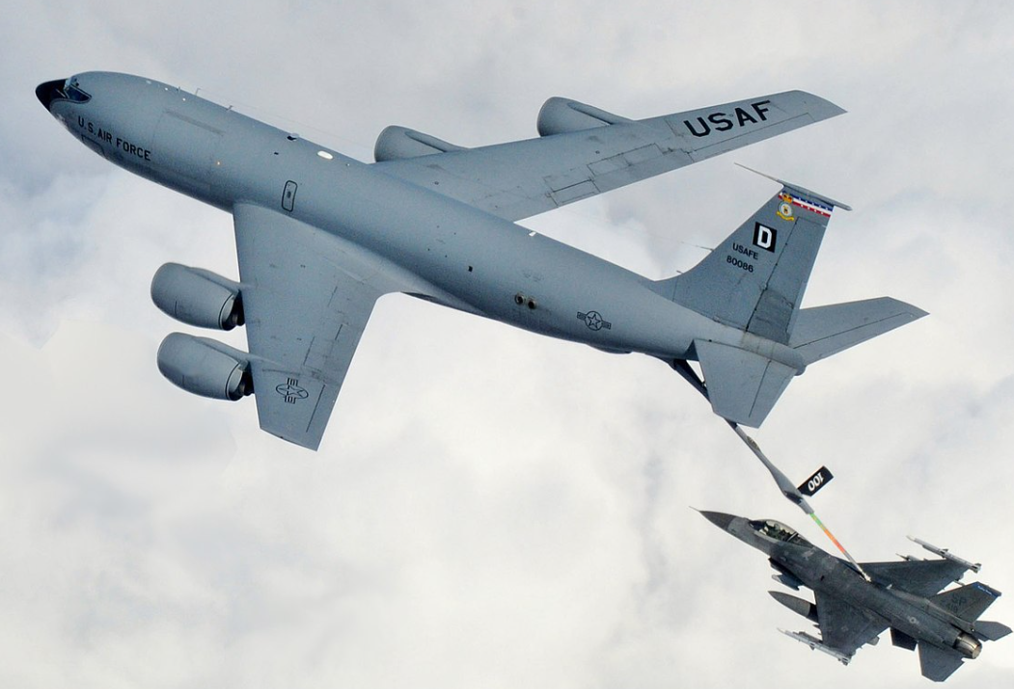

Slide 3
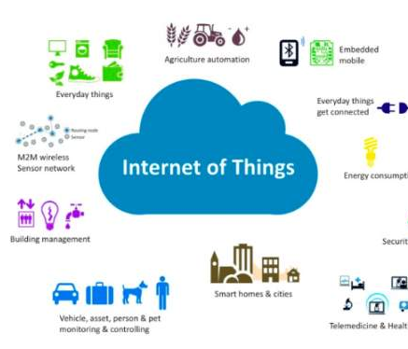
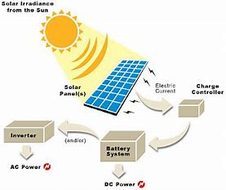
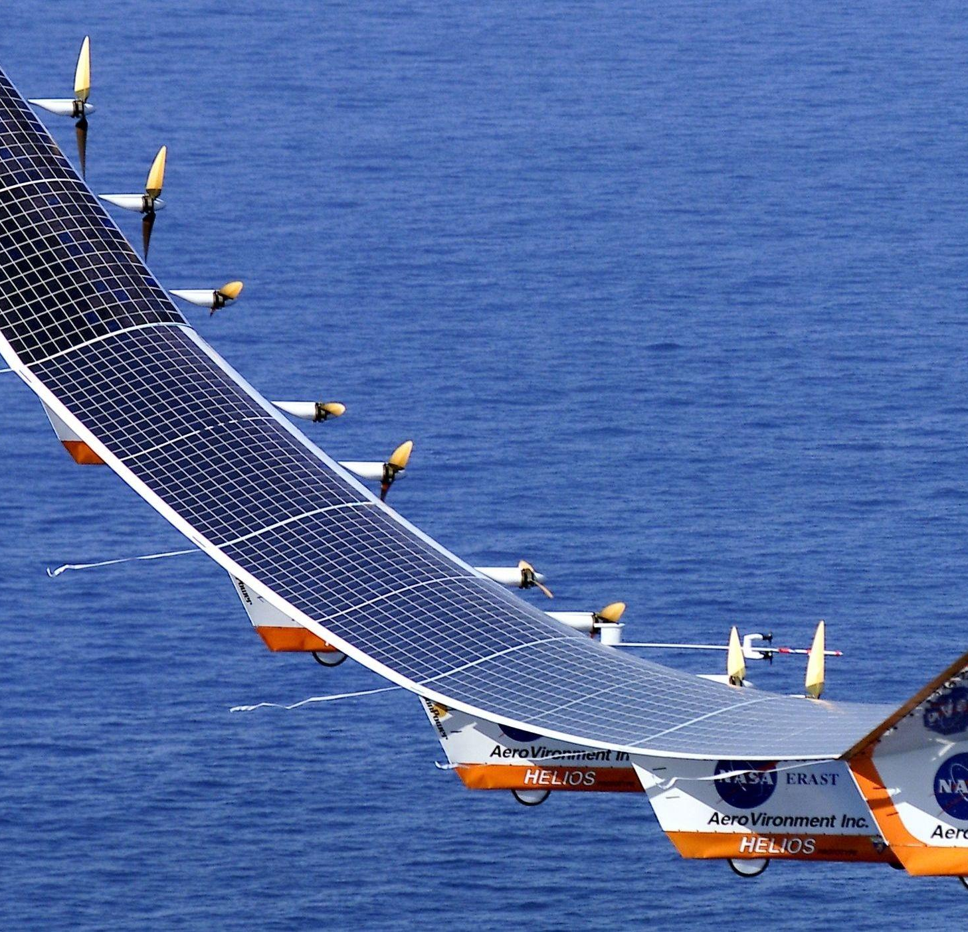
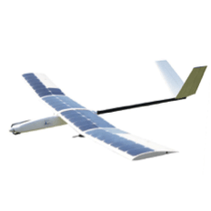
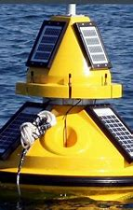
Introduction
Powering IoT devices is huge challenge:
One of the viable solution is to power these IoT devices (and Drones) is solar energy.
Solar Energy is Omnipresent and most efficent source of renewable energy
Surfacing as prime source to feed power to evolving technology
Solare energy brings the carbon footprint considerably down.
Minimizes weight of drones & IoT devices by enhancing solar charging capability
Solar Energy is converted to electrical energy by photovoltaic (PV) panel.
Solar changing of battery will extend the flying time of drone:
Titan Aerospace build a ‘Solar 50’ with 50-meter wingspan will fly 15 miles in clear weather.
Similarly, recharging of outdoor IoT devices can extend the battery life to support the user and business needs
AeroVironment HALE (High Altitude Long Endurance) drones
Sunbirds design and sells solar drones that can travel for 10+ hours under ideal conditions. Their solar drones fly autonomously and can also be controlled by remote control. Sunbirds solar drones are equipped with cameras to use for mapping and aerial photograph.
Powering IoT Devices with renewable sources removed many barriers. However, the unpredictable nature of weather and solar radiation keeps the uncertainty of operational hours
Buoys Are: A waterborne IoT device sends a constant data stream to monitor water conditions.

Slide 4
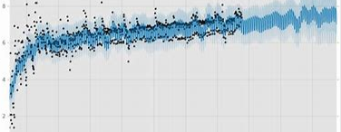

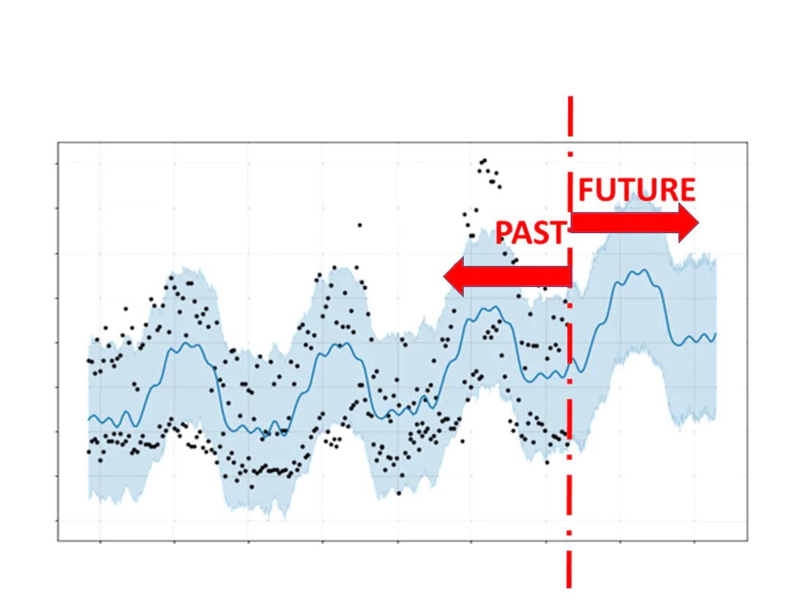

Problem Statement: To improve the accuracy of short-term solar radiation forecast to power drones, IoT devices, and others that have short term power needs.
Contributions: Three Prime contributions are:
Creating and ensemble model using Facebook’s Prophet, Amazon’s Deep AR+ and Amazon CNN-QR
Comparing the results with algorithms that are being used to forecast solar radiation like VAR
Improve the accuracy of short- term solar radiation forecast
Novelty:
None of the methods leveraged Neural Network models like Facebook’s Prophet, Amazon’s Deep AR+ and Amazon CNN-QR to predict GHI
Leveraging other metrological variable to predict the Solar Radiation
Create an ensemble model to further enhance the prediction results

Slide 5
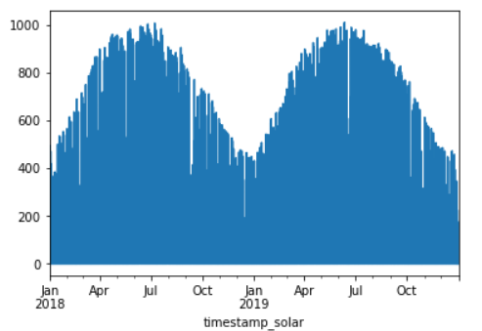
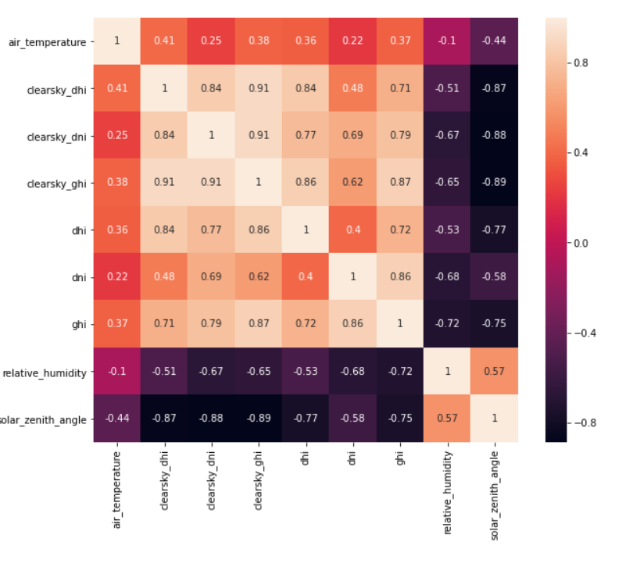
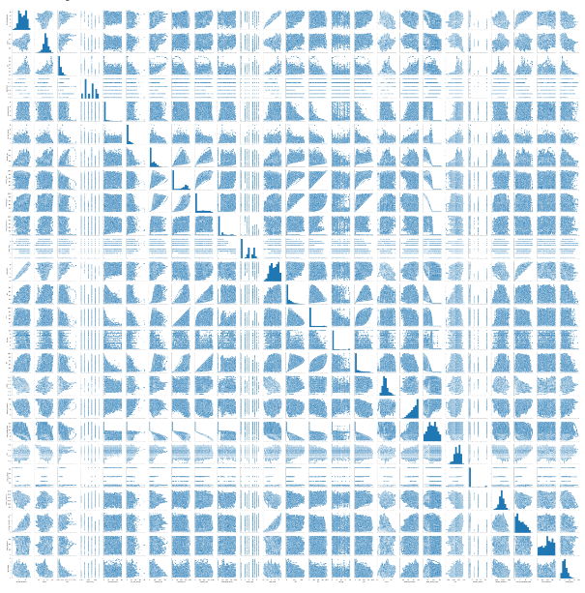
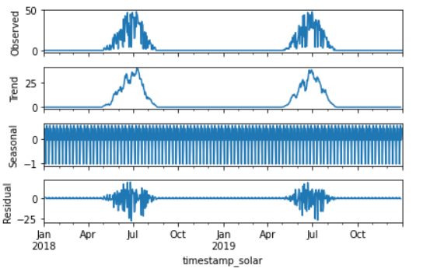
Data
Data Trend
Correlation Plot
Looks very similar year over year
Some of the variable show high correlation
Duration
Fm: 2018 to 2019
Sample Collected
Every 30 minutes
Data Size
Rows: 35,040
Column: 29
Pair Plot
Data Decomposition
Correlation is not significant after 3rd lag
Data show trend and seasonality

Slide 6
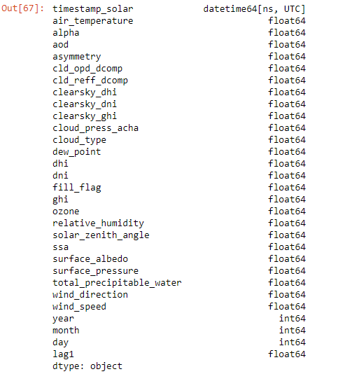
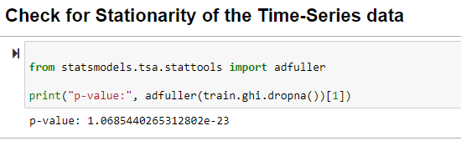
Stationary Test
Dickey-Fuller test was carried out to check if time serise data is stationary. P value derived from test is below significant level indicating that the serise is stationary.
All the variables in data set were either float or integer.

Slide 7
Method
Three method listed below will be use to derive the short-term solar Radiation forecast. They come with their strength to explore and forecast.
DeepAR
It is used to forecast time series using recurrent neural networks (RNN), handle a huge dataset, and support more features and scenarios
Prophet
CNN-QR
It show superiority for time series without a long history and rare occurrences.
It shines when applied to time series data that have strong seasonal effects and several seasons of historical data to work.

Slide 8
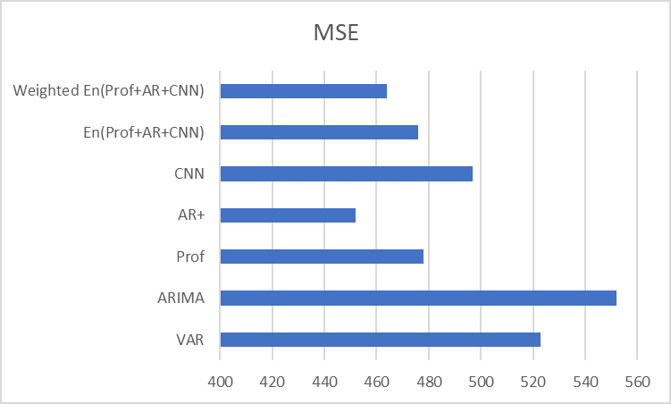
Results
This is Dummy data; values will be adjusted after actual values are derived

Slide 9
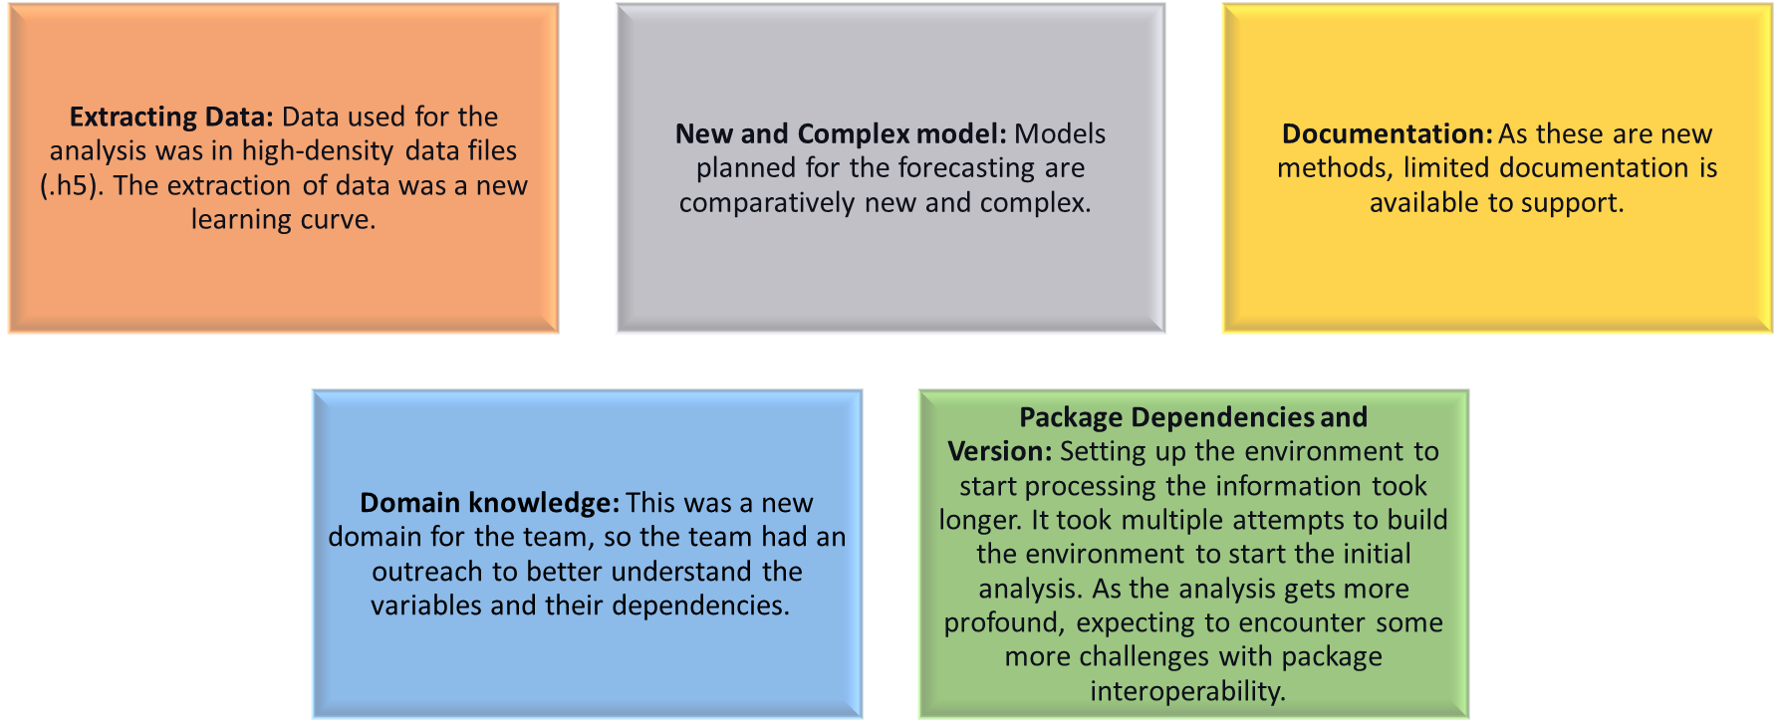

Challenges

Slide 10
Discussion/Ethics

Slide 11
Conclusions

Slide 12

Questions?

Slide 13
Citations
1. Foad H. Gandoman, Shady H.E. Abdel Aleem, Noshin Omar, Abdollah Ahmadi,
Faisal Q. Alenezi. Short-term solar power forecasting considering cloud coverage and ambient temperature variation effects.
2. S.K. Aggarwal, L.M. Saini. Solar energy prediction using linear and nonlinear regularization models: A study on AMS (American Meteorological Society) 2013-14 Solar Energy Prediction Contest.
3. Emre Akarslan, Fatih Onur Hocaoglu, Rifat Edizkan. A novel M-D (multidimensional) linear prediction filter approach for hourly solar radiation forecasting.
4. Fatih Onur Hocaoglu, Faith Serttas. A novel hybrid (Mycielsi-Markov) model for hourly solar radiation forecasting.
5. Benali, G. Notton, A. Fouilloy, C. Voyant, R. Dizene. Solar radiation forecasting using artificial neural network and random forest methods: Application to normal beam, horizontal diffuse and global components.
6. Ayu Wazira Azhari, Kamaruzzaman Sopian, Azami Zaharim, Mohamad Al Ghoul. School of Environmental Engineering, Universiti Malaysia Perlis, 01000 Kangar Perlis, Malaysia
7. El-Sayed M. El-Kenawy,Seyedali Mirjalili,Sherif S. M. Ghoneim, Marwa Metwally Eid, M. El-Said ,Zeeshan Shafi Khan, Abdelhameed Ibrahim, Advanced Ensemble Model for Solar Radiation Forecasting Using Sine Cosine Algorithm and Newton’s Laws.
8. David Salinas, Valentin Flunkert, Jan Gasthaus, Tim Januschowski, DeepAR: Probabilistic forecasting with autoregressive recurrent networks.
9. H. Aguilera a, C. Guardiola-Albert a, N. Naranjo-Fern´andez and C. Kohfahl b. Department of Research in Geological Resources, Spanish Geological Survey, Madrid, Spain, Towards flexible groundwater-level prediction for adaptive water management: using Facebook’s Prophet forecasting approach
10. Emir Zunic, Kemal Korjenic, Sead Delalic, and Zlatko Subara. Comparison analysis of Facebook’s Prophet, Amazon’s DeepAR+ and CNN-QR algorithms for successful real-world sales forecasting

Slide 14
Appendix

Slide 15
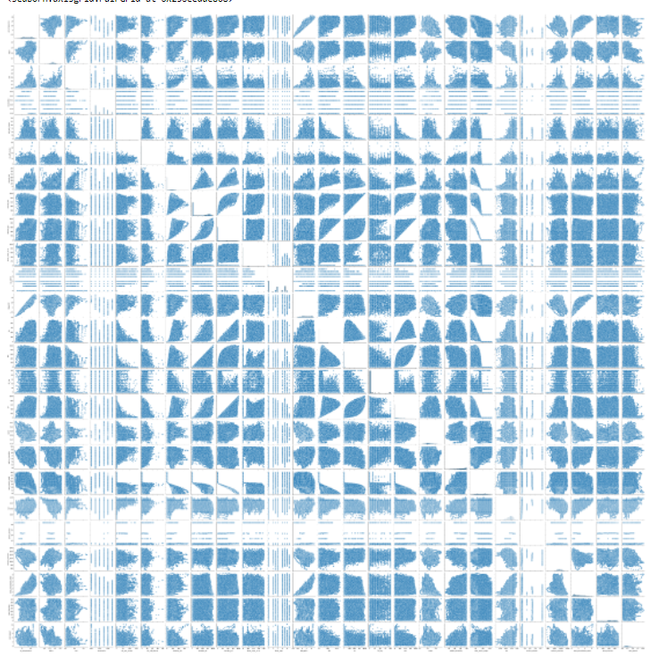
Pair Plot

Slide 16
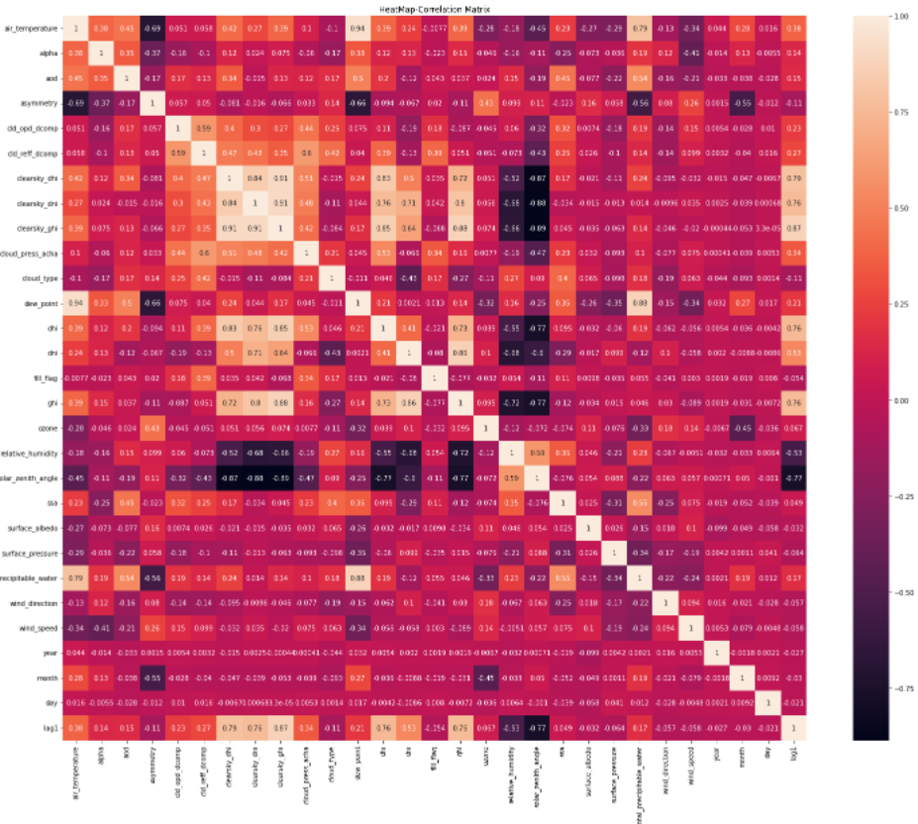
Correlation Plot

Slide 17
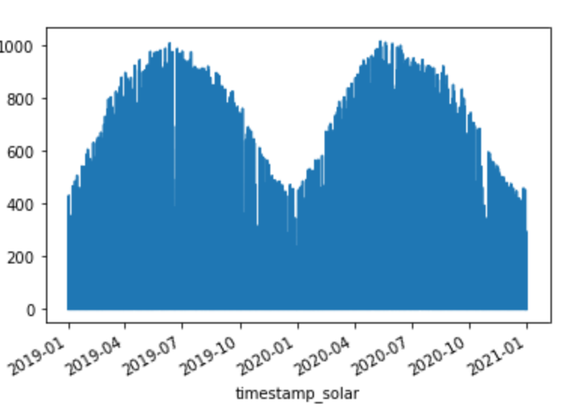
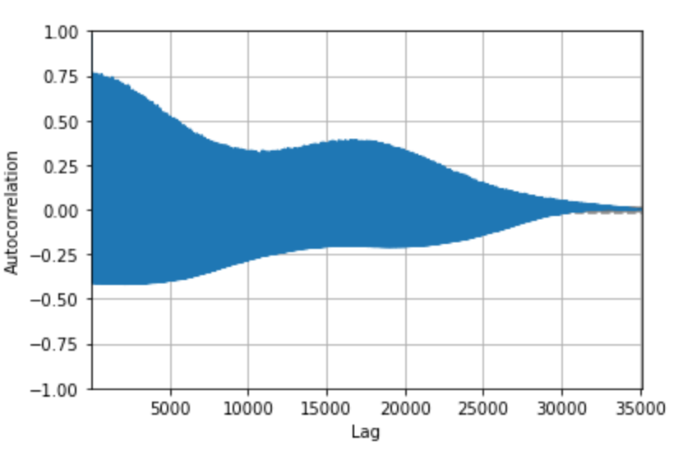
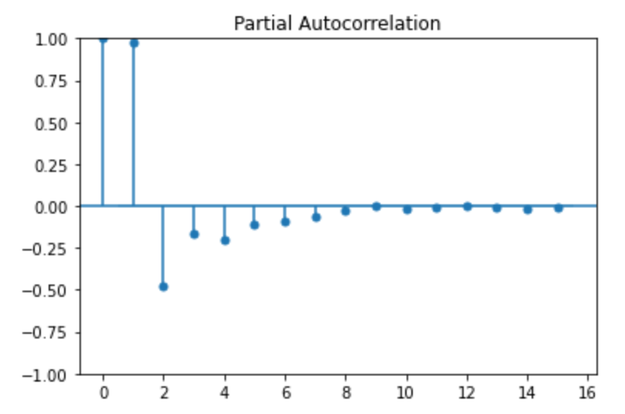
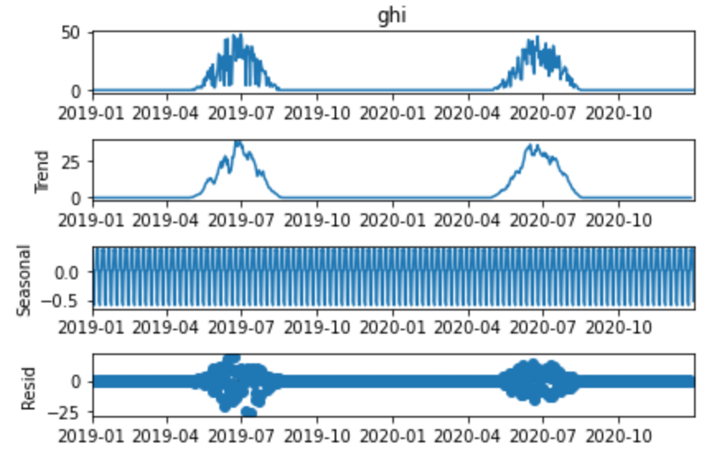
Data
Data Trend
Auto Correlation Function (ACF)
Diminishing sinusoidal AFC
Duration
Fm: 2019 to 2020
Sample Collected
Every 30 minutes
Data Size
Rows: 35,088
Column: 23
Looks very similar year over year
Partial Autocorrelation Function (PACF)
Data Decomposition
Correlation is not significant after 3rd lag
Data show trend and seasonality

Slide 19
Challenges
Extracting Data: Data used for the analysis was in high-density data files (.h5). The extraction of data was a new learning curve.
New and complex model: Models planned for the forecasting are comparatively new and complex.
Documentation: As these are new methods, limited documentation
is available to support when encountering the challenge.
Understanding the domain knowledge: This was a new domain for the team, so the team had an outreach to better understand the variables and their dependencies.
Package Dependencies and Version: Setting up the environment to start processing the information took longer. It took multiple attempts to build the environment to start the initial analysis. As the analysis gets more profound, expecting to encounter some more challenges with package interoperability.

Slide 20
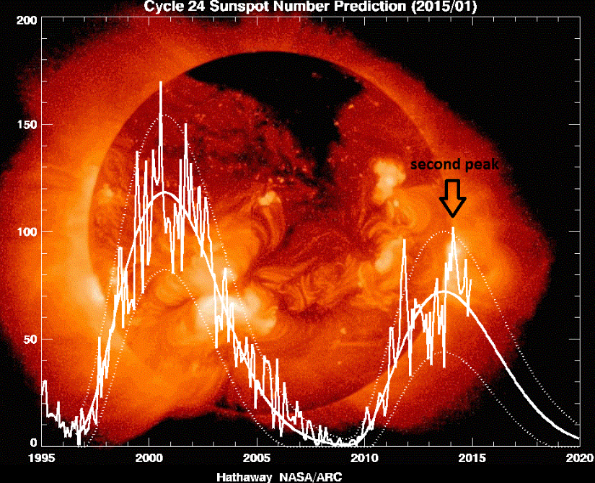
Problem Statement
To improve the accuracy of short-term solar radiation forecast to power drones and IoT devices.
Three prime contribution of the paper are:
Creating and ensemble model using Facebook’s Prophet, Amazon’s Deep AR+ and Amazon CNN-QR
Comparing the results with algorithms that are being used to forecast solar radiation like VAR
Improve the accuracy of short- term solar radiation forecast

